Slide 1
Organizational Level Changes Station Design & Procedures
Jonathan Lund, PE, EFO
Fire Marshal
Des Moines Fire Department

Slide 2

Project goals
points of emphasis for the design of fire station 11:
a station that embraces wellness and fitness initiatives including, but not limited to:
  reducing preventable injuries through facility design,
  cancer prevention (isolation and mitigation of contaminants),
  workout and fitness space,
  ambient conditions, and
  individual sleep spaces;
a station that maximizes efficiency for “turn-out” times by:
  reducing impediments between call notification and apparatus “in-route” status, and
  reduces travel distances between frequently occupied areas of the station and the apparatus locations;
efficient and effective classroom training space.

Slide 3

Code
Compliance
Business
Storage
residential

Slide 4
Station
Functionality
Living spaces
  Kitchen
  Day room
  Sleeping
  Fitness
Work spaces
  Report room
  Training
separated spaces
    Apparatus bay
    Extraction
    Decon areas

Slide 5
HVAC Design –
Apparatus Return & Exit
Minimum constant ventilation
(negative pressure)
Beam detection for integrated
exhaust purge upon return (180 seconds)
  low air intake, high exhaust location
    purge options for small engine checks
    gas detection purge system
Track mounted direct capture exhaust
  addresses worst case scenario (engine start)
Positive pressure vestibules
Separate HVAC for living spaces

Slide 6
Hot, warm & cold zones
Blue areas positively pressurized
Purple areas are the positively pressurized vestibules
Red areas negatively pressurized

Slide 7
Decon scenarios
5 primary scenarios considered:
EMS – Hand Wash
EMS – Post CPR
Post Fire PPE
Post Fire Chain Saw
SCBA Replenish
Notes:
Hand Wash Station:
Big Trash Can
Sink
Pink Soap
Gojo
LAVA
Hand Sanitizer
Hand Lotion
Paper Towel
Kill Mat - Shoes
Post Fire Chain Saw:
Rinse/brush off debris
Set on bench
Disassemble
Replace
Reassemble: scrub, wash, dry, blow
Run
Place on rig
Post Fire SCBA:
Rinse/brush off debris
Swap Bottle
Clean Face mounted regulator
Clean SCBA Face Piece
3 tub sink w/ 2 side boards
Stage, wash, sanitize, rinse, dry
Drying rack
Blow dryer?
9-12 Peg hanging dry rack
Post Fire PPE Doff: 6’x6’
Decon Shower
Disassembly
Walk into nook
Stool/bench
Needs:
Short brush
Long brush
Light
Shower wand
Hot & Cold
2 stage drain w/ trap
Boot tread brush

Slide 8
Post Fire Decon
Process must
make sense
Design must
reinforce
Desired procedures

Slide 9
Gross Decon & Extraction
6’ x 6’ Gross decon shower
  Two-stage drain, compressed air, shower wand
Three compartment sink
with drying rack
  for scba and facepieces
Extractor
Entrance to gear storage

Slide 10
Medium Decon
Easy to clean hard surfaces
Individual lockers
  Spare uniform
  toiletries
Washer/dryer
Single point of entry
Pass-through to showers
  Reinforce procedures through design

Slide 11
Medium Decon Room
Cross sectional views

Slide 12
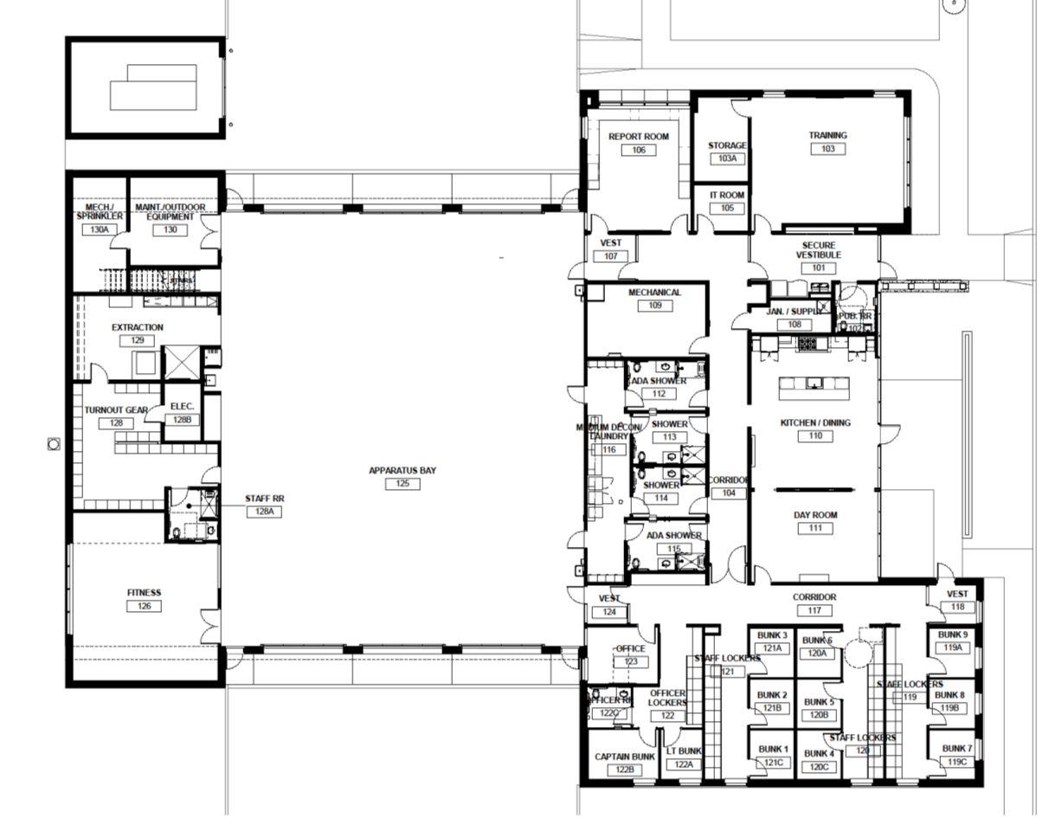
Other Health & Wellness
Design Features
v
Natural Light Options
Blackout Shades
STC ratings between bunk rooms
Individual alerting equipment in rooms
Garden & Rainwater System
Noise Reduction through separation
Handwash stations

Slide 13



Design team
SVPA Architects – Senior Architect Josh Ridgely, AIA
WSKF Architects – Fire Station Consultant, Rick Kuhl, RA, MBA
City of Des Moines –
Facilities Director Jim Hoff, Project Engineer Tim Brady
Des Moines Fire – Fire Station Committee
Asst. Chief Percy Coleman, Fire Marshal Jonathan Lund, Captains Dave Leever & Chad Smeins, Lieutenant Tim Nemmers, Sr. Medic Laura Lyons, Engineer Jeff Watson, Firefighter Stacia Swanson

