Slide 1
Cancer in the Fire Service
Patrick Morrison
Assistant to the General President for Occupational Health, Safety and Medicine

Slide 2
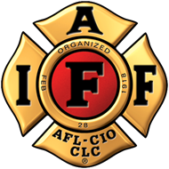
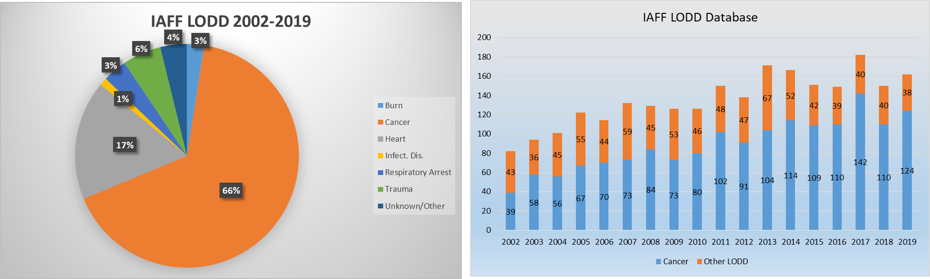
SCOPE OF THE PROBLEM
Headline
IAFF FALLEN FIRE FIGHTER MEMORIAL AND loDD DATABASE

Slide 3
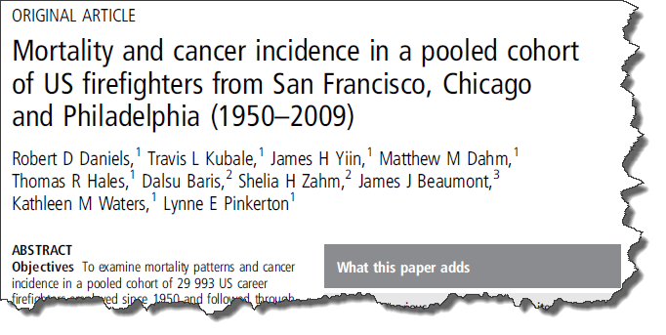
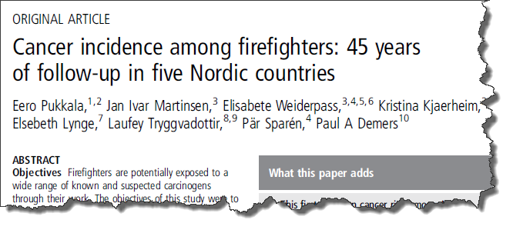
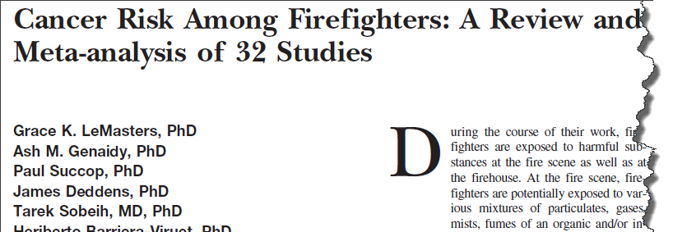
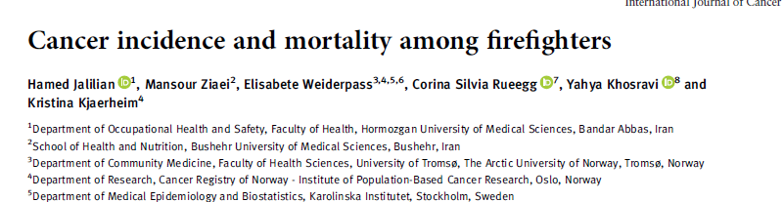
RESEARCH
Key Studies:
LeMasters Meta-Analysis
NIOSH Study
Nordic Study
Jalilian Meta-Analysis

Slide 4

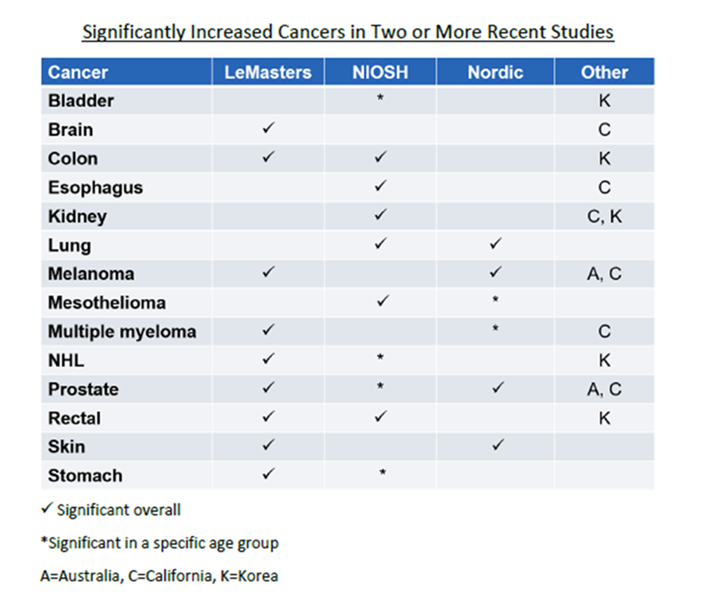
OCCUPATIONALLY LINKED CANCER

Slide 5

IAFF RESEARCH PROJECTS
Per/Polyflouroalkyl Substances (PFAS) Blood Study
  This is a study on the amount of PFAS within fire fighters’ blood to determine if it is greater than the general population.
U.S./Canadian Fire Station Flame Retardant and PFAS Dust Study
  Dust samples from ﬁre stations that were collected have been analyzed for flame retardants and per/polyflouroalkyl substances (PFAS).
Testing Turnout Gear Material for PFAS
  Select outer shell, thermal barrier and moisture barrier materials will be tested for PFAS chemicals and their amounts.

Slide 6
IAFF RESEARCH PROJECTS
University of Miami- Thyroid Study
University of Miami FCI team screened fire fighters at two conferences for thyroid and endocrine system disruptors, screened for skin cancer and collected toenail clippings to analyze for heavy metals.
Arizona Blood Cohort Study
  A prospective study to collect information on fire fighter exposures and other risk factors, while also collecting blood samples to identify precursors to cancer.
Ottawa Dermal Decon Study
  Collected 88 samples and evaluating for PAH metabolite and DNA damage in pre and post firefighting activities
Notes:
Ottawa is also analyzing samples for pre- and post- fire mutagenicity analyses and pre- and post-fire DNA damage analyses. This data they are hoping to use for the IARC reevaluation.

Slide 7
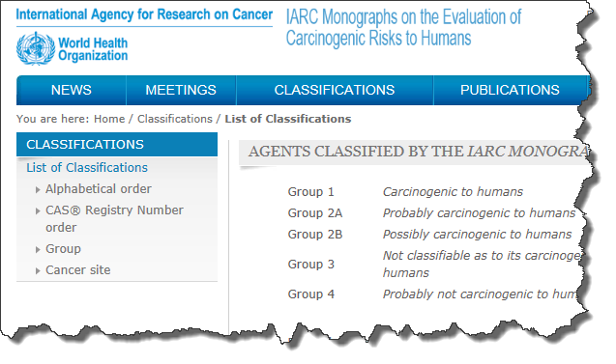
IARC - Overall Evaluation
Occupational exposure as a firefighter is possibly carcinogenic to humans (Group 2B).

Slide 8
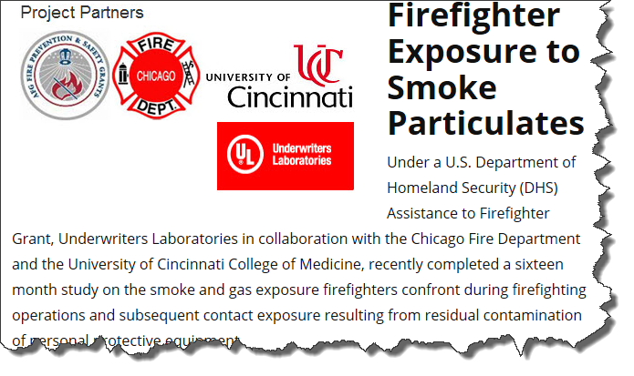
EXPOSURES
Carcinogenic chemicals
found in smoke include:
  Benzene
  Chromium
  Formaldehyde
  Polycyclic Aromatic Hydrocarbons (PAHs)
Flame retardants
PFAS
Asbestos fibers
Diesel engine exhaust

Slide 9

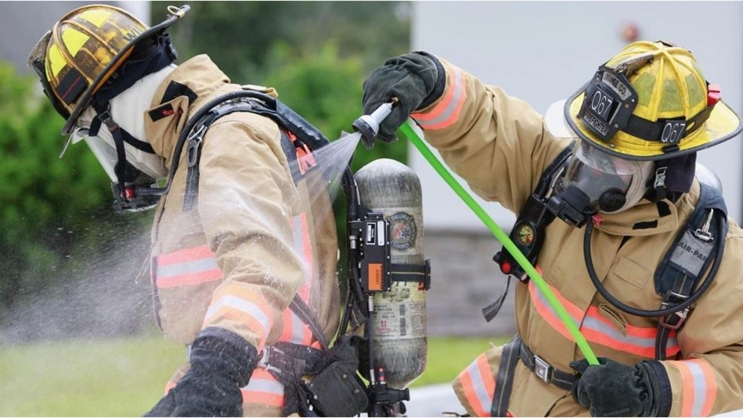
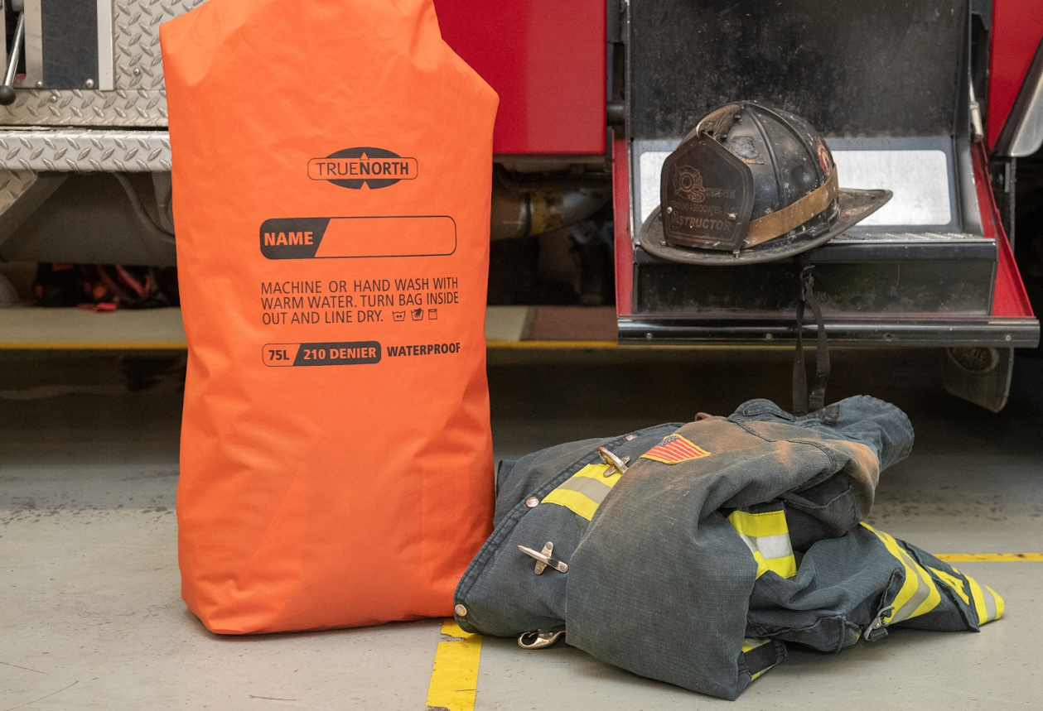
PROTECT YOURSELF ON THE JOB
Reduce your exposure by:
  Wear your SCBA during all firefighting activities- suppression, overhaul and gross decontamination
  On scene gross decontamination and bag gear
    Wet decon is preferred
  Do not take contaminated gear or tools in the cab
  Shower when you return to the station
Notes:
NIOSH Wet decon can remove up to 85%, dry brush is 23%

Slide 10
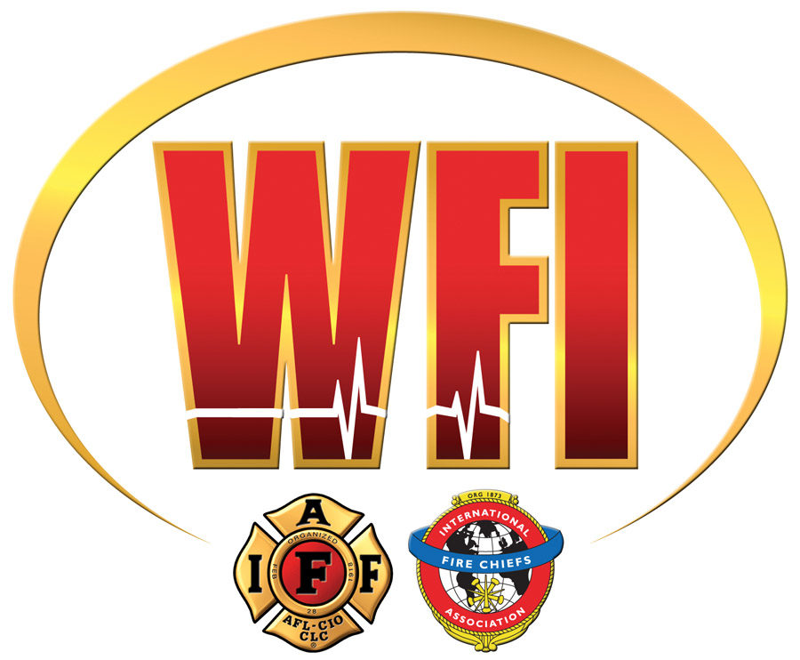
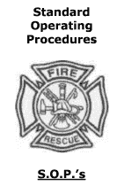
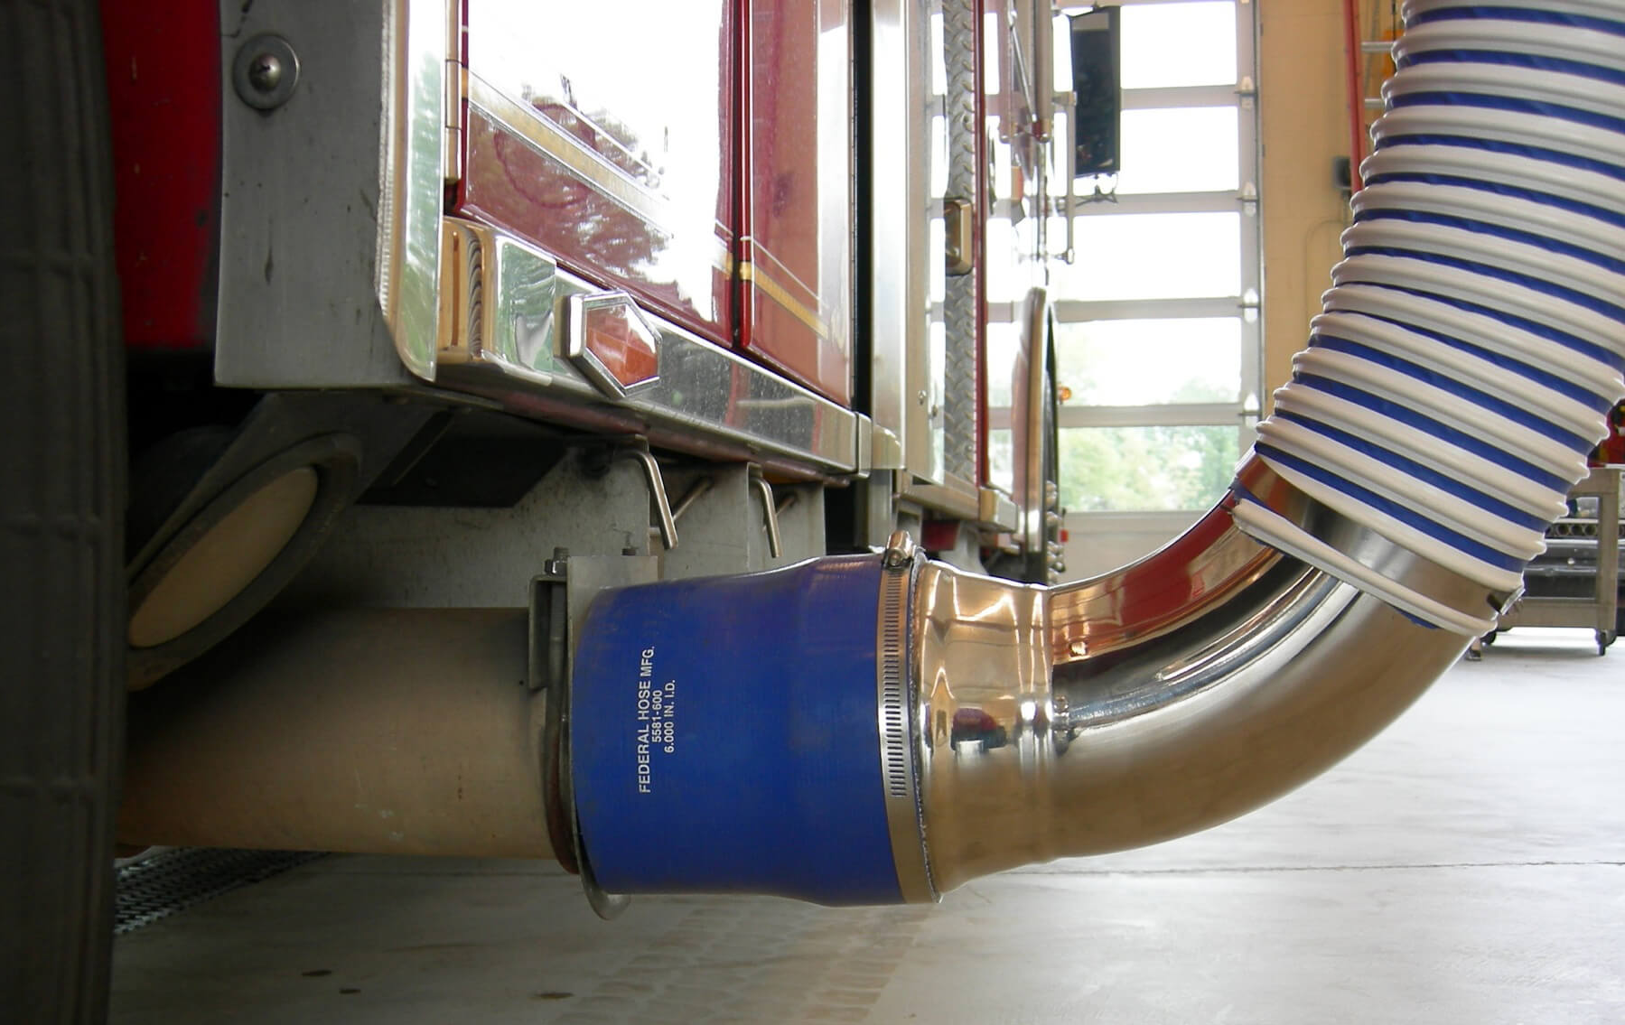

ORGANIZATIONAL EFFORTS TO REDUCE EXPOSURE
Cancer prevention SOP’s/SOG’s
Contamination prevention measures for vehicles and fire stations
Stations outfitted with diesel exhaust capture systems
Fire Department wellness, fitness and nutrition programs
Notes:
NIOSH Wet decon can remove up to 85%, dry brush is 23%

Slide 11

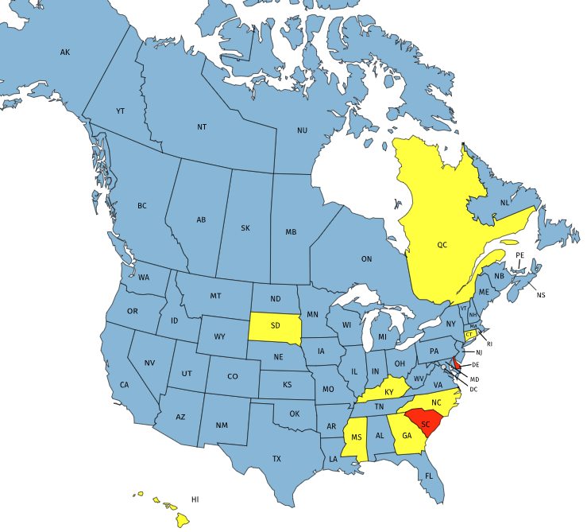
PRESUMPTIVE LEGISLATION
Presumptions in
41 States and
12 Province/Territory
Benefit eligibility in
7 States and
1 Province/ Territory
Presumption
Benefit Eligibility
No Presumption or Benefit Eligibility

Slide 12
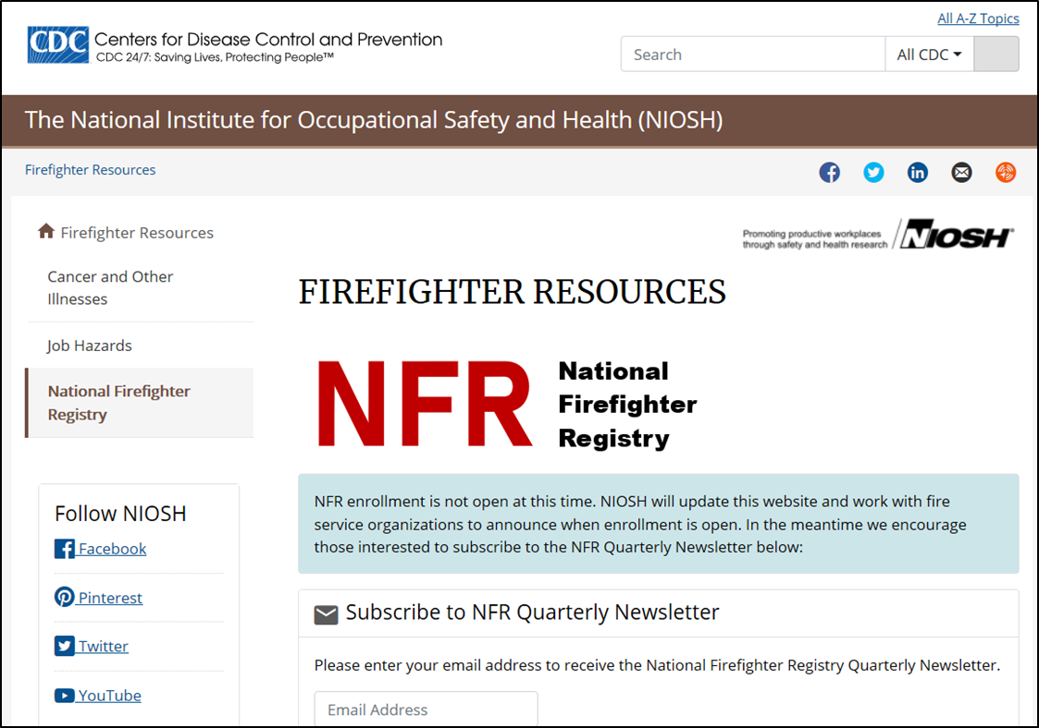
Firefighter Cancer Registry Act of 2018

Slide 13

IAFF’s LEGISLATIVE EFFORTS
Flame Retardants
H.R. 2647 / S. 1341, Safer Occupancy Furniture Flammability Act (SOFFA)
  Reduces use of toxic flame retardants by adopting a modern smolder flammability test standard
  Per-Polyfuloroalkyl substances (PFAS)
  FAA Reauthorization Act of 2018: Airports no longer required to use PFAS-laden foam
  Protecting Military Firefighters from PFAS Act: Blood testing for DoD fire fighters
  Okeo-Tex 100 (PPE third party testing)
  Asbestos
  H.R. 1603 / S. 717, The Alan Reinstein Ban Asbestos Now Act
  Bans the manufacture, import, processing and distribution of asbestos

Slide 14

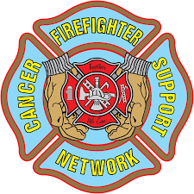
IAFF PARTNERSHIPS
American Cancer Society MOU
The IAFF and ACS will collaborate together to make cancer resources more readily available through these projects:
Fire fighter specific cancer prevention programs and resources
Fire fighter specific patient support programs
Fire Fighter Cancer Support Network
The IAFF and FFCSN will collaborate together to share ideas and conduct research to ensure the most current information is reaching fire fighters.
We will create a fire fighter cancer awareness month.

